Slide 1
BMGT 347: Final Presentation
By: Samantha Wehmer, Leslie Kwok, Brian Garfunkel, Arthur Lin

Slide 2
Introduction
Overview:
Forecast excess returns on stocks based on individual company factors through various regression techniques
Purpose:
Identify most important predictors in forecasting excess returns of any stock

Slide 3
Data Manipulation
Dropped data in dataset where major economic events occurred resulted in market disruption
Black Monday Crash - 10/1987
Friday the 13th Mini-Crash - 10/1989
Dot-com Bubble - 03/2000 to 10/2002
2008 Financial Crisis - 09/2008 to 03/2009
Reduced rows of data from 502,636 → 470,413

Slide 4
Regression Methods & Techniques
OLS Regression
Incorporated all predictors (43)
Lasso Regression
Shrink coefficients of 10 less important variables to 0
Include: net operating asset, return on equity, asset turnover, leverage, etc
Ordered variable coefficients to see variable predictability
Random Forest Regression
n_estimator = 100; max_depth = 7
Ranked feature importance

Slide 5
Performance Metrics
Random Forest
Train MSE: 0.01112 Train R²: 0.03201
Test MSE: 0.00962 Test R²: -0.0267
Lasso
Train MSE: 0.01141 Train R²: 0.0063
Test MSE: 0.00943 Test R²: -0.006
OLS
Train MSE: 0.01141 Train R²: 0.00667
Test MSE: 0.00944 Test R²: -0.007
Best Model
In Sample: Random Forest
Out of Sample: Lasso

Slide 6
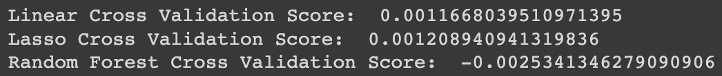
Best Model Evaluation
Split data into 10 folds (cv = 10), and took mean
Used R² as the scoring parameter in cross validation
Lasso Model Performance Metrics in the Test Sample
Test MSE: 0.00943
Test R²: -0.006

Slide 7
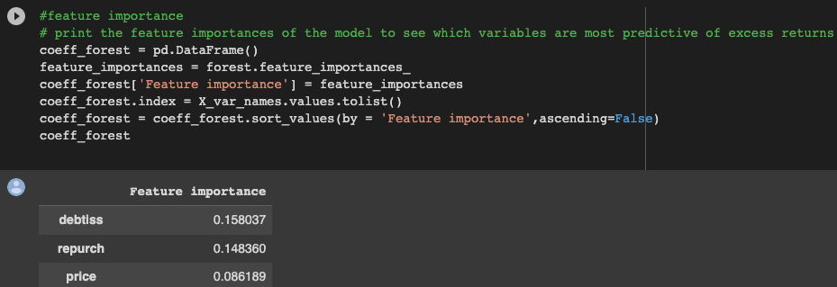
Predictability and Variable Importance
Most important variables for predictability:
Debt Issuance (debtiss): Binary variable equal to one if long-term debt issuance indicated in statement of cash flow. Updated annually.
Share Repurchases (repurch): Binary variable equal to one if repurchase of common or preferred shares indicated in statement of cash flow. Updated annually.
These variables are highly irregular; unable to predict.
Would NOT start Hedge Fund

